Slide 1
Award for Technical Excellence FY2019 Industry and Offering CTO reviews (Due October 10th)
Artie Kalemeris & David Stevens

Slide 2
The Award
Given each year for outstanding achievements in delivered client solutions
One award may be given in each of six categories
Team members receive the award. Up to FOUR people may be included on a team.
Awards are selected based on excellence in technology, execution and results
Complete program description at https://my.dxc.com/our-company/global-functions/technology-office/dxc-awards-for-technical-excellence-.html

Slide 3
Award Process
Open window for field to submit solutions to Digital Explorer
Regional CTOs each nominate one solution from their region in each category
Offering, Industry and Delivery CTOs rate the nominations
Global CTO presents recommended awards to Decision Committee
Decision Committee/CEO confirm final awards and announcement to winners
September 1st ~ 17th
October 1st
October 10th
October 15th
December
WE ARE HERE

Slide 4
FY2019 Award Schedule
September 1 – 17 | Field submits solutions to Digital Explorer
October 1 | Regional CTO nominations due
October 10 | Industry, Offering, Delivery CTO reviews complete
October 15 | Global CTO presents recommended winners to Decision Committee
December | Winners Notified

Slide 5
Industry & Offering CTO Process
Review solutions nominated in your category (see spreadsheet)
Review detailed datasheet within Digital Explorer
OPTIONAL : Rate and comment within DE (note this will be visible to all DXC employees) see slide 14
REQUIRED: Complete the rating spreadsheet and return to akalemer.
OPTIONAL: Request the solution contacts to enrich their solutions further
Send your completed spreadsheet to akalemer@dxc.com by October 10th

Slide 6
Award Selection Criteria
Technology Excellence
The deep technology acumen, domain knowledge and product expertise the team applied to create a world-class solution for the client that demonstrates a key transformational shift(s) and moves the client along its digital transformation journey. The high levels of design, development, integration and leverage of open and/or next-gen technologies the team demonstrated.
Execution Excellence
The technological and process-driven precision the team applied, including timeliness and cost-effectiveness.
Results
The meaningful value for the client and DXC Technology that resulted from the team’s work. This could be a new core capability, an innovation, significant savings, or new use for a solution from our portfolio.
Solutions must be delivered to the client. Internal projects are not eligible.

Slide 7
Categories & Reviewers
Category | Reviewers | Link to nominations
Agile Applications and Digital Experiences | JP Morgenthal | Go to slide
Enabling the Enterprise Through Hybrid Cloud | Jim Miller | Go to slide
Empowering Workforces with Invisible IT | Marc Wilkinson | Go to slide
Thriving on Enterprise Data and Analytics | Dragan Rakovich | Go to slide
Managing Enterprise Risk in a Connected World | Chris Moyer | Go to slide
Industry Specific Transformation | Femi Ladega, Brian Wallace, Kavi Pelpola | Go to slide

Slide 8
Agile Applications and Digital Experiences
Solution Name | Region | Account | DE Link | Review Outcome
Digital Transformation - Crew Training Instructor Self Scheduling Responsive Web Application | America | American Airlines | Ctrl-Click to view
India Post Bank Countrywide Banking Solution | Asia | India Post Bank | Ctrl-Click to view
XR (Mixed Reality) Forensics | ANZ | Government law enforcement agency | Ctrl-Click to view
DTU set up and Agile and DevOps project solution | N & C Europe | Zurich EMEA | Ctrl-Click to view
 | S Europe
 | UKIIMEA
Place an “X” in the review outcome column for your chosen solution
Only 1 selection per category

Slide 9
Enabling the Enterprise Through Hybrid Cloud
Solution Name | Region | Account | DE Link | Review Outcome
 | America
- | Asia | - | - | -
- | ANZ | - | - | -
DXC Composer | N & C Europe | - | Ctrl-Click to view
DXC Lambda | S Europe | Flemish Government | Ctrl-Click to view
 | UKIIMEA
Place an “X” in the review outcome column for your chosen solution
Only 1 selection per category

Slide 10
Empowering Workforces with Invisible IT
Solution Name | Region | Account | DE Link | Review Outcome
- | America | - | - | -
- | Asia | - | - | -
- | ANZ | - | - | -
DXC Medical Coding | N & C Europe |  | Ctrl-Click to view
- | S Europe | - | - | -
 | UKIIMEA
Place an “X” in the review outcome column for your chosen solution
Only 1 selection per category

Slide 11
Thriving on Enterprise Data and Analytics
Solution Name | Region | Account | DE Link | Review Outcome
EMMA - Enhanced Machine learning & Multilayered Analytics for P&G | America | P&G | Ctrl-Click to view
- | Asia | - | - | -
- | ANZ | - | - | -
Daimler IT for Autonomous Driving (IT4AD) | N & C Europe | Daimler AG | Ctrl-Click to view
Using data analytics to make roads safer | S Europe | Flemish Government | Ctrl-Click to view
 | UKIIMEA
Place an “X” in the review outcome column for your chosen solution
Only 1 selection per category

Slide 12
Managing Enterprise Risk in a Connected World
Solution Name | Region | Account | DE Link | Review Outcome
AppFit (“Application Fitness”) | America | P&G | Ctrl-Click to view
Firewall Rules Strategy & Improvement | Asia | DXC (VPC) | Ctrl-Click to view
Smart AR Energy | ANZ | Essential Energy | Ctrl-Click to view
Security patching and reporting automation using DXC Standard Toolset (BigFix) | N & C Europe | General Electric Company | Ctrl-Click to view
- | S Europe | - | - | -
 | UKIIMEA
Place an “X” in the review outcome column for your chosen solution
Only 1 selection per category

Slide 13
Industry Specific Transformation
Solution Name | Region | Account | DE Link | Review Outcome
Quote Generation with smart speakers | America | Farmers (Zurich) | Ctrl-Click to view
ePOS - Electronic Point of Sales for Insurance | Asia | Manulife | Ctrl-Click to view
Marksmanship application | ANZ | Armed Forces | Ctrl-Click to view
CSAVAR | N & C Europe | Magyar Telekom Deutsche Telekom | Ctrl-Click to view
- | S Europe | - | - | -
 | UKIIMEA
Place an “X” in the review outcome column for your chosen solution
Only 1 selection per category

Slide 14
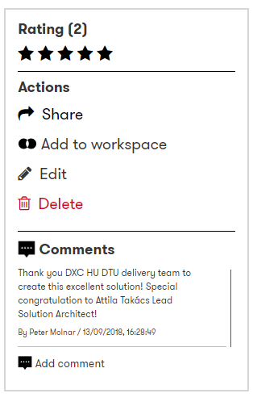
Rate and comment within Digital Explorer
As you review the solution within Digital Explorer, you have the option to use the ratings and comments option to provide direct feedback for the solution owners and also others who view the datasheet later.
Note : These comments are visible to anyone within DXC

Slide 15
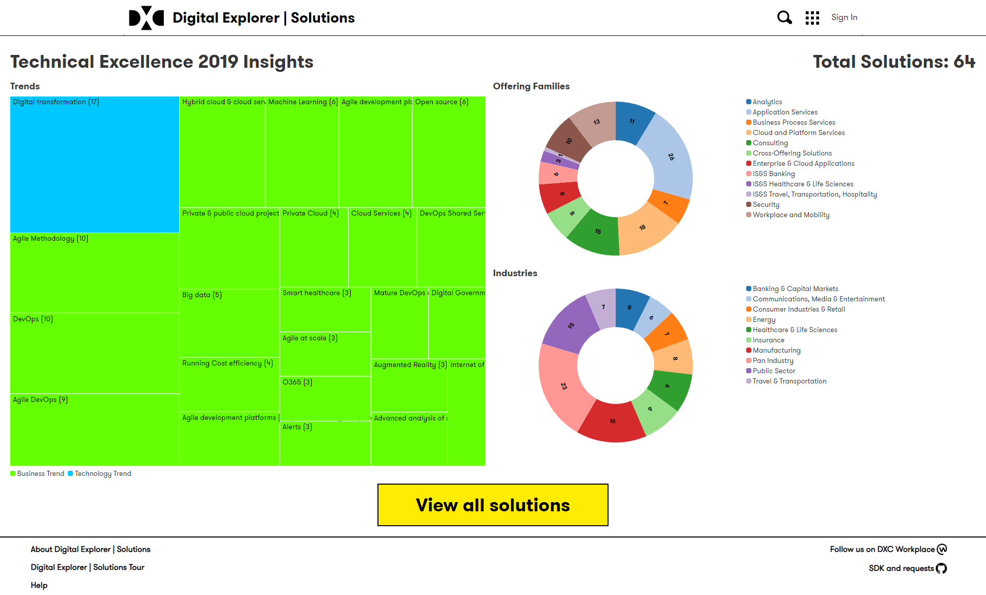
https://digitalexplorer.dxc.com/se/techexcellence/dashboard

